Slide 1

“Digital Logic Design”
Lecture # 14

Slide 2
SOP Boolean Function Simplification Using K-Map
Minimize the following SOP expression,
F(x, y, z) = Σ(0,2,6,7)
F(x, y, z) = Σ(0,2,3,4,6)
F(x, y, z) = Σ(0,1,2,3,7)
F(x, y, z) = Σ(3,5,6,7)
F(x, y, z) = Σ(0,1,5,7)
F(x, y, z) = Σ(0,1,6,7)
F(x, y, z) = Σ(1,2,3,6,7)

Slide 3
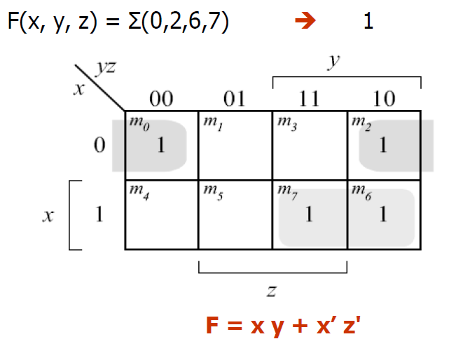
SOLUTION(1-7)

Slide 4
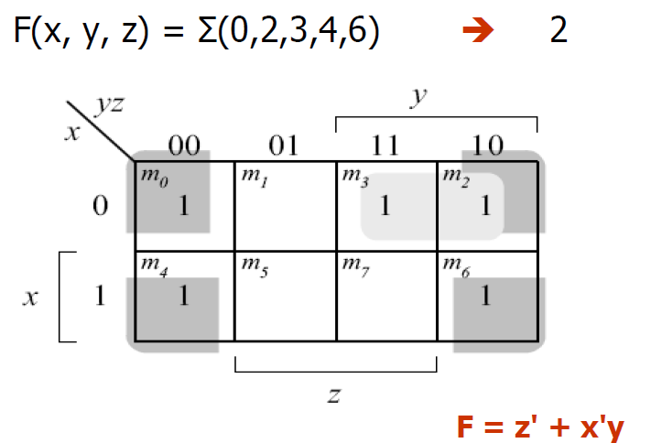

Slide 5
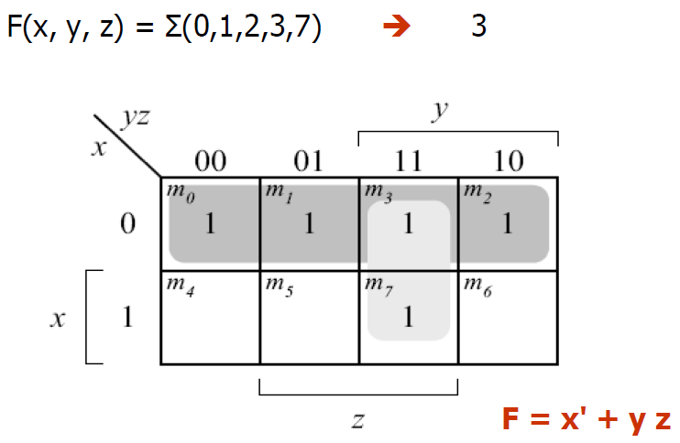

Slide 6
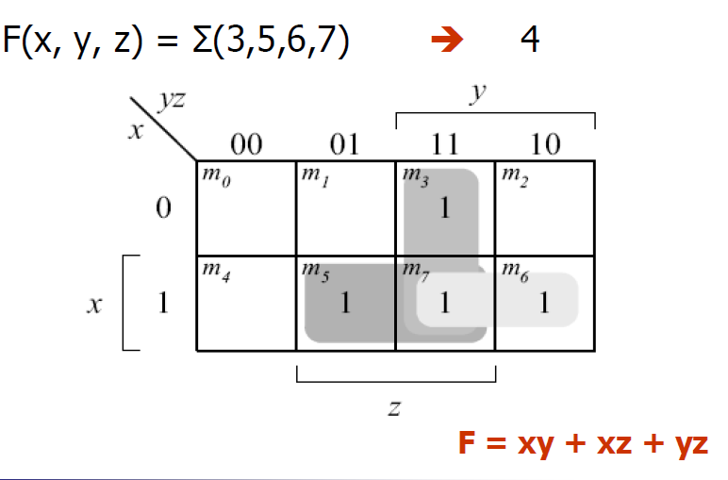

Slide 7
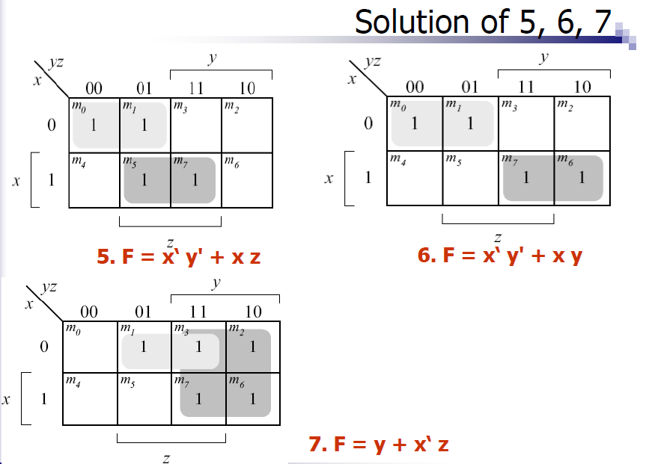

Slide 8
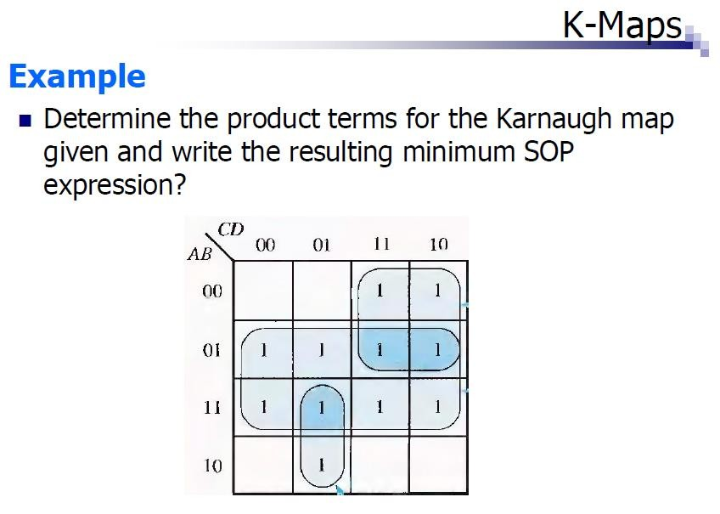

Slide 9
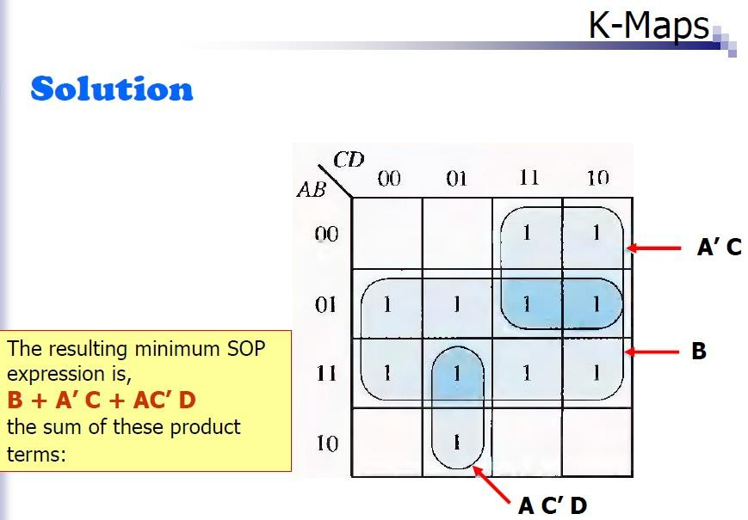

Slide 10
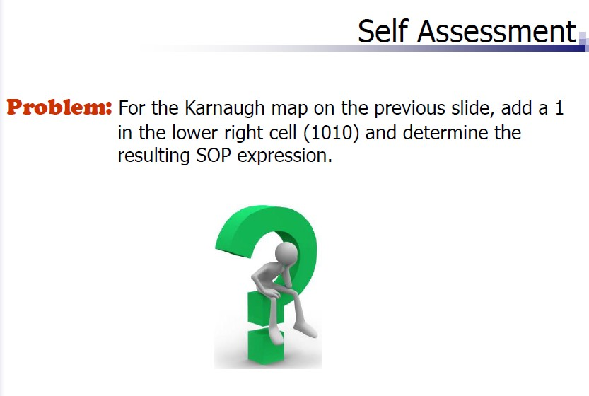

Slide 11
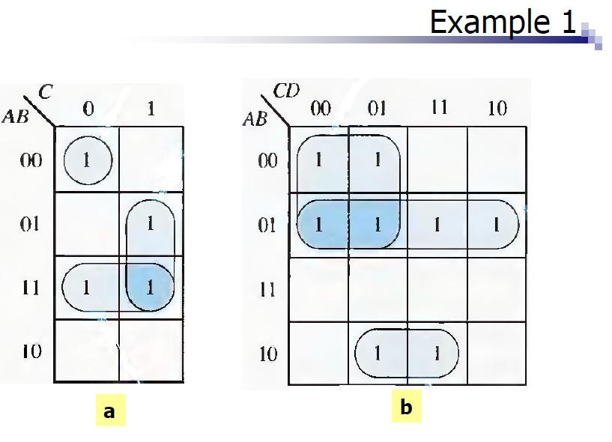

Slide 12


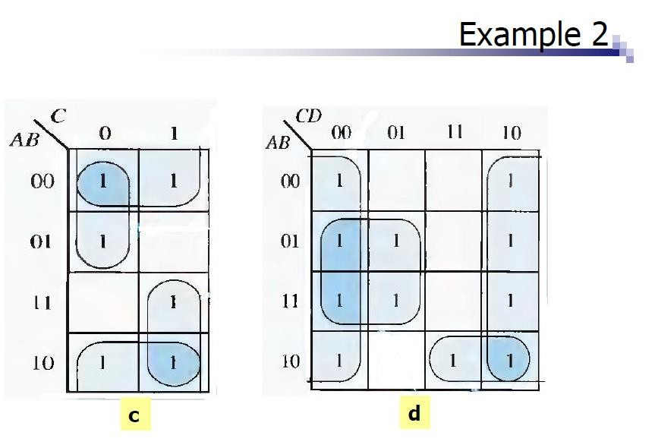


Slide 13
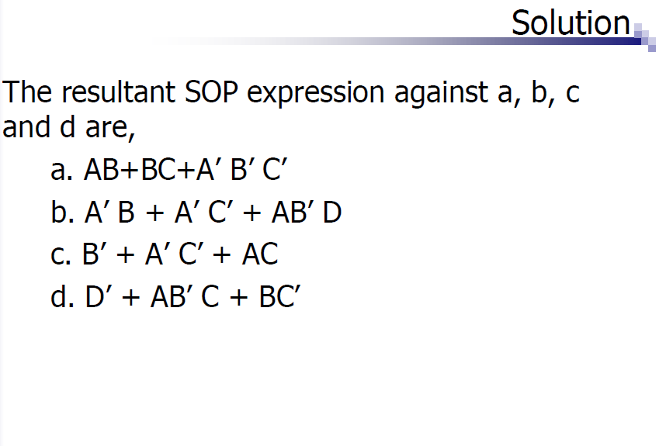

Slide 14
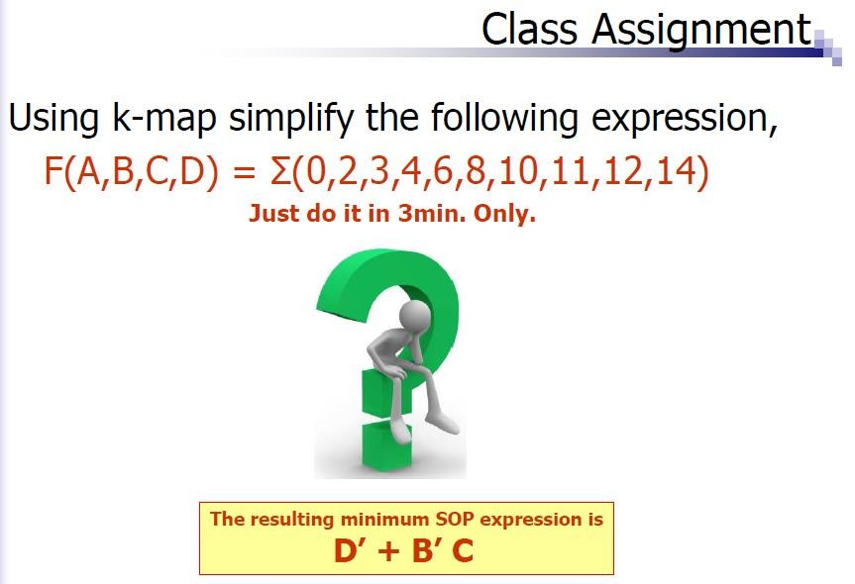

Slide 15
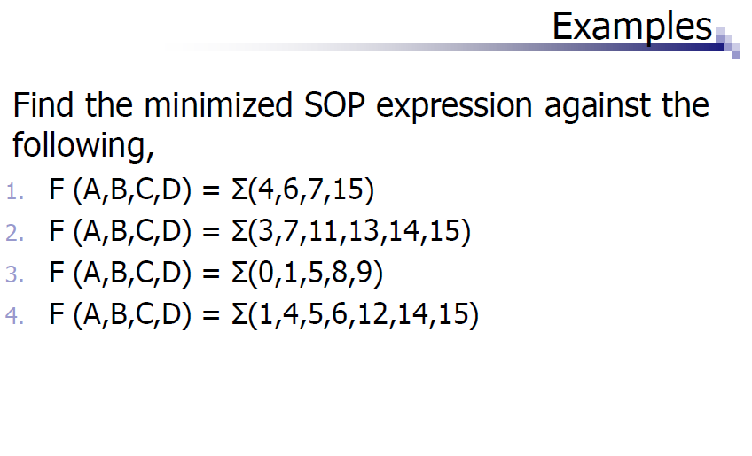

Slide 16
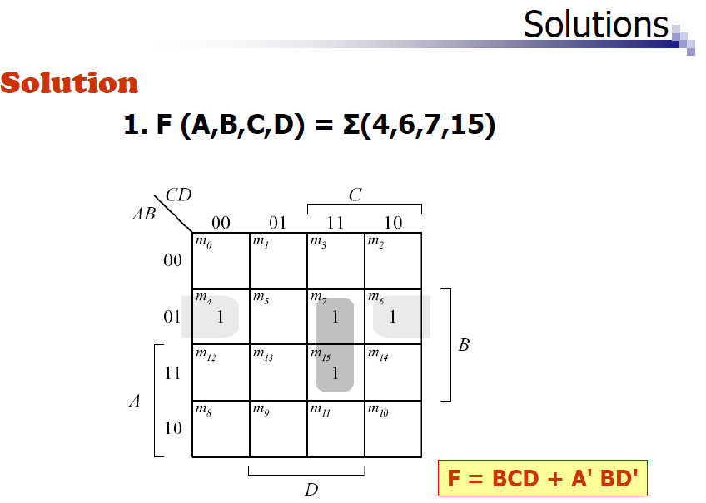

Slide 17
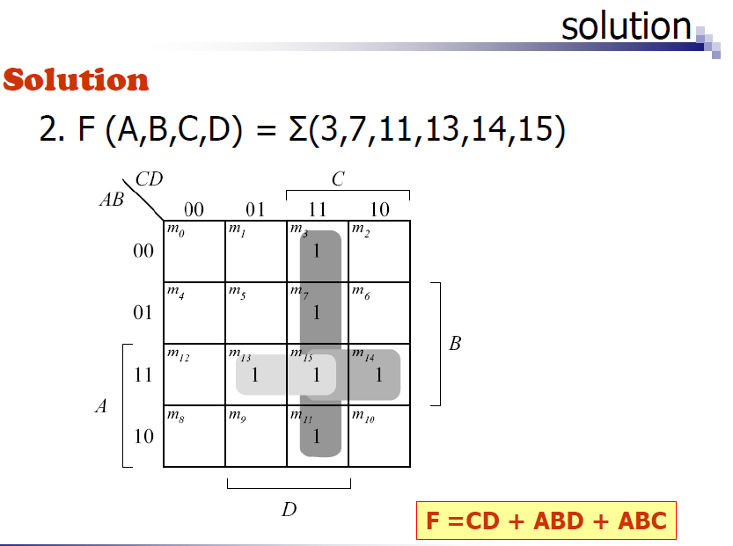

Slide 18
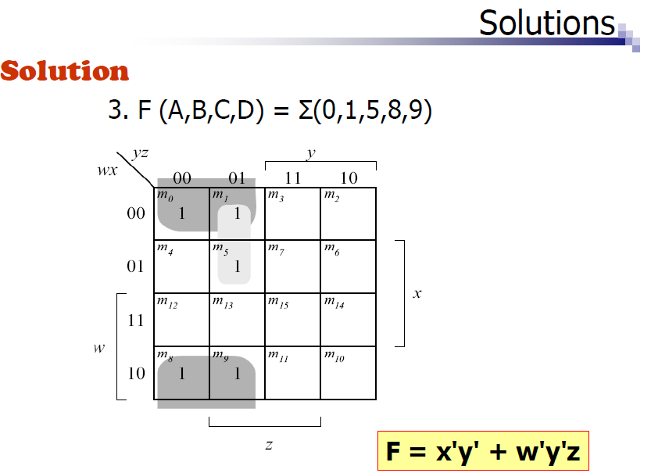

Slide 19
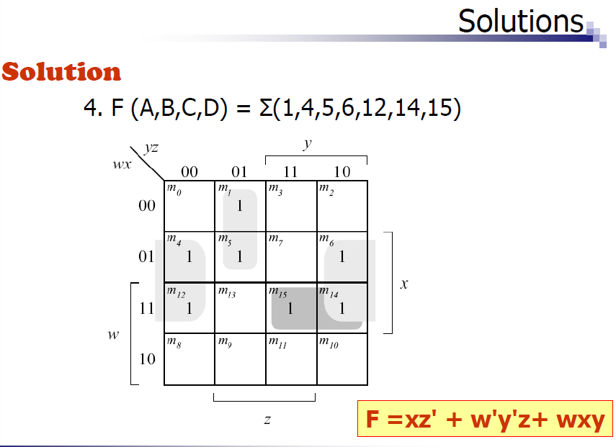

Slide 20
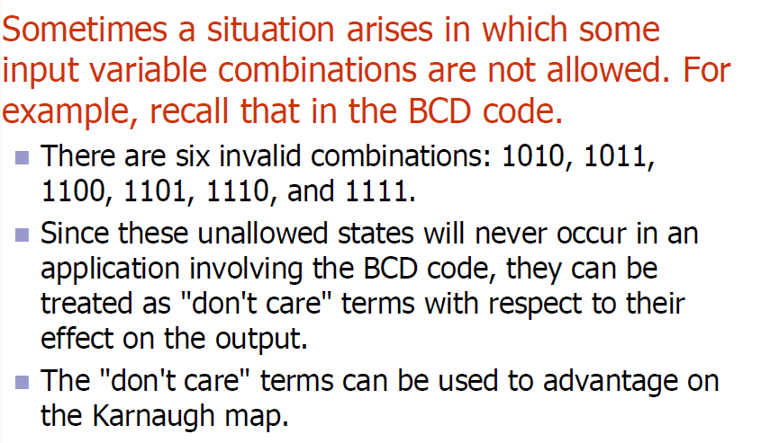
Don’t care conditions

Slide 21
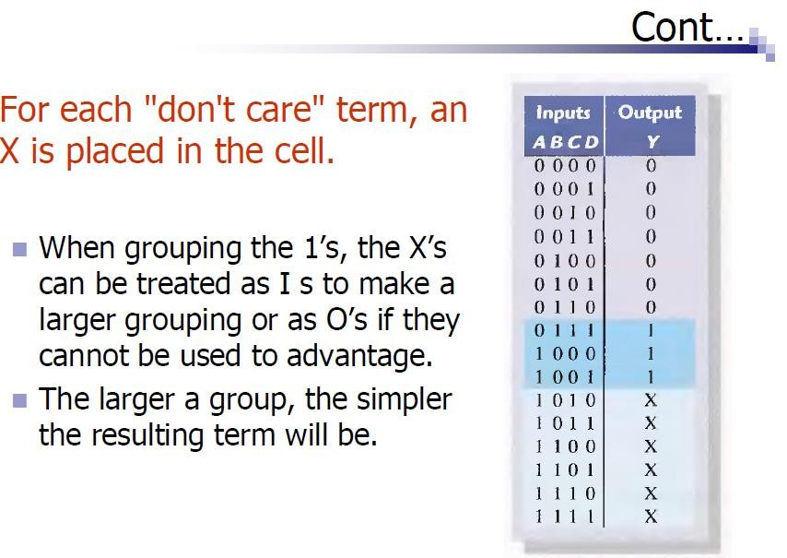

Slide 22
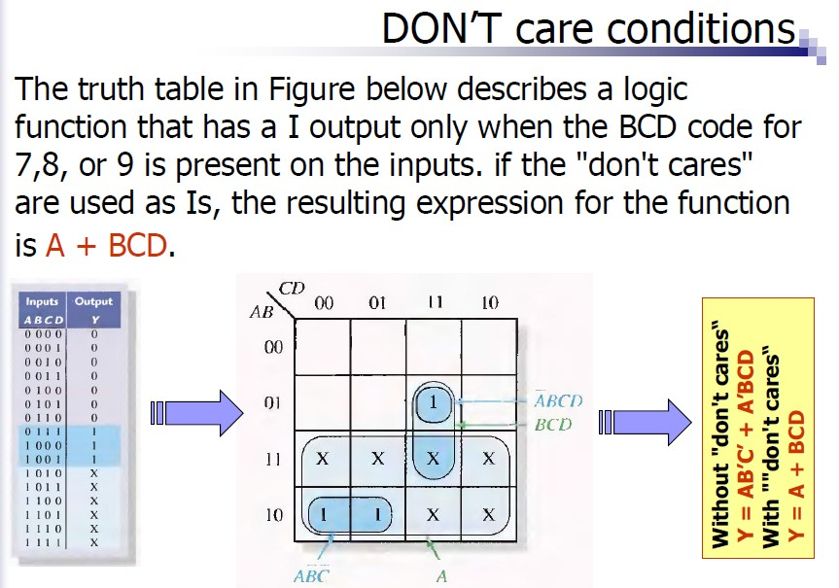

Slide 23
